Slide 1
Private Development 101
From the citizen perspective
Provided by : Oregon City Public Works

Slide 2

Private Development 101
What is private development?
Residential Subdivision
Residential Partition
Apartment/Condo Complex
Townhome Development
Cottage Homes
Office Buildings
Restaurants
Manufacturing
Anything that is built on private property no matter the owner
Notes:
This also includes properties owned by a public entity doing work on their property such as the new police building and new public works building.

Slide 3

Private Development 101
Private Development – Process Categories
Type I
  Over the Counter review, no public process
Type II
  Staff Review with ability for public comment
Type III
  Planning Commission Approval with ability for public comment
Type IV
  Planning Commission Recommendation with ability for public comment
  City Commission Approval with ability for public comment
Notes:
Type I examples : Building Addition, Addition of a pool, New fence, Retaining Wall, Carport, Lot Line Adjustment, Building Repairs, Driveway, Utility Service, Sidewalk, Tree Removal/Replacement, Special Events, Filming
Type II examples : Standard subdivision (4 or more lots), partition (3 or less lots), Apartments/Condos/Townhomes, Office/Manufacturing, Government Buildings, Restaurants/Retail – anything that follows the City Code standards + Geologic Hazards and most NROD
Type III examples : Variances, Master Plans, Most Conditional Uses
Type IV examples : Annexations, Certain Conditional Uses, Rezone

Slide 4

Private Development 101
The Process
Property Inquiry
Pre-Application Conference
Land Use Application
Land Use Decision
Permit Submittal
Permit Approval
Pre-Construction Meeting
Construction
Project Closeout
2-Year Maintenance Period

Slide 5
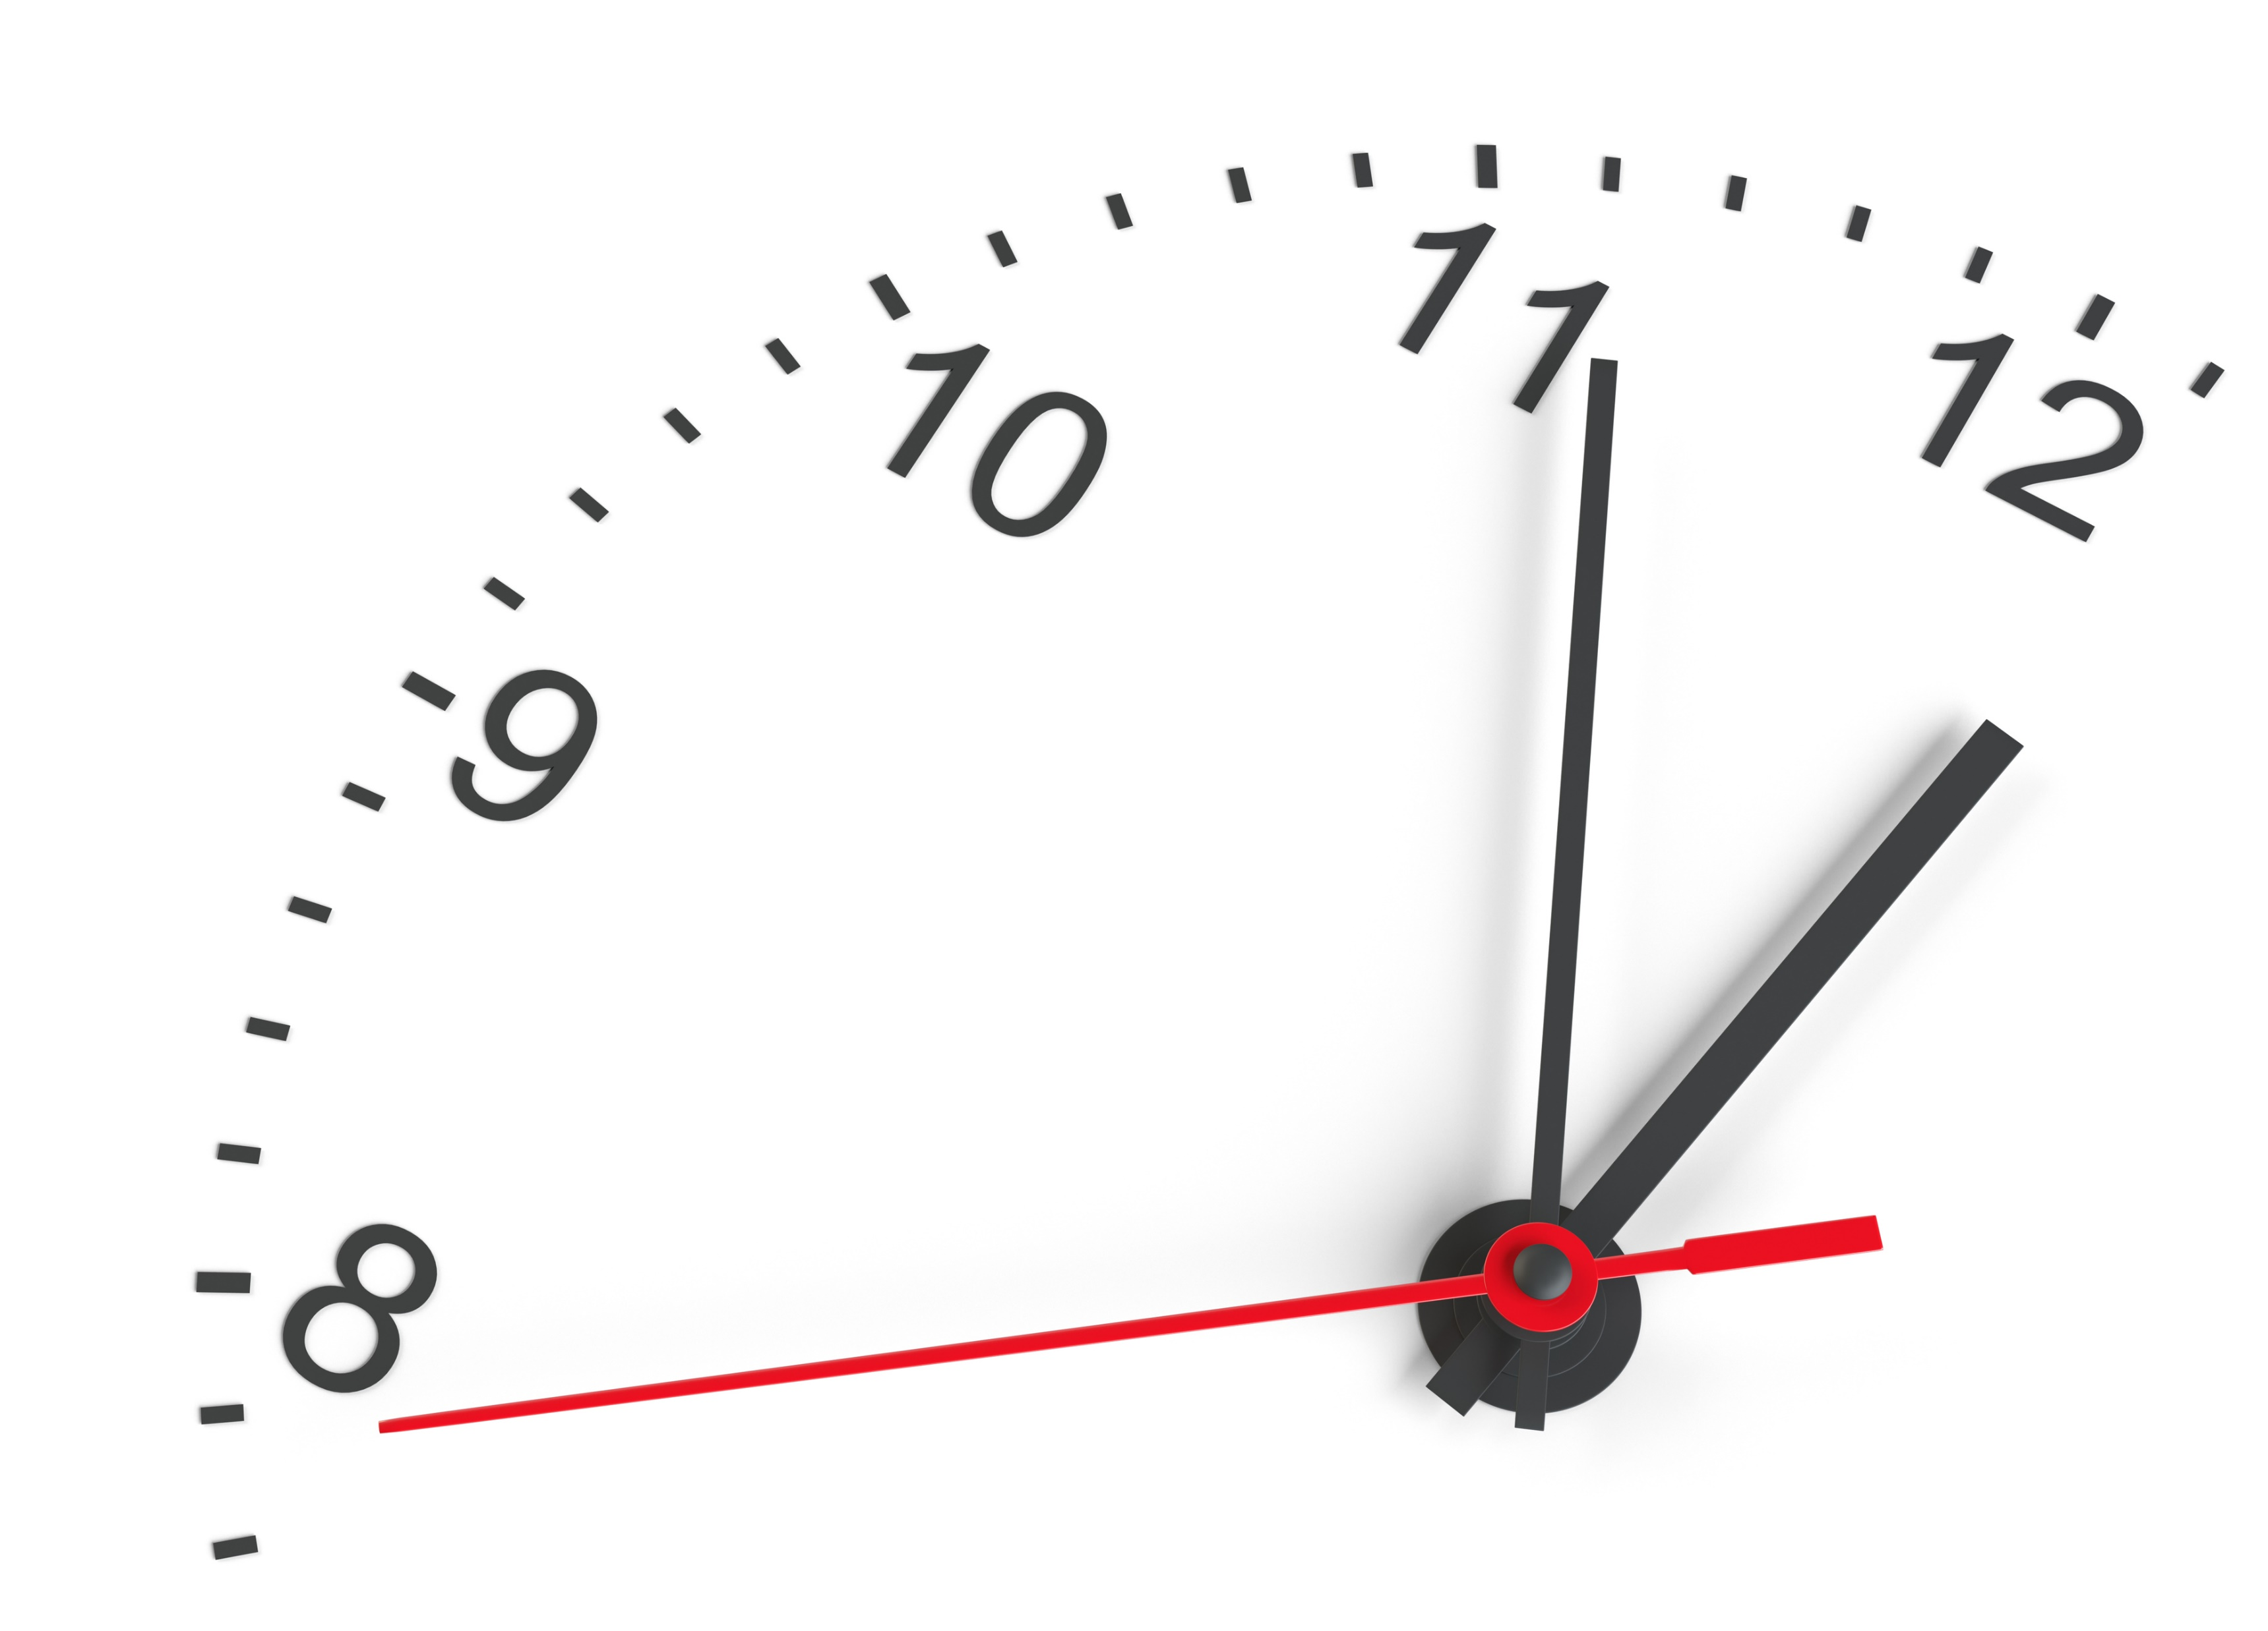
Private Development 101
The Process - Timeline
Property Inquiry – Occurs on a regular basis
Pre-Application Conference – Scheduled approx. 3 weeks after application
Land Use Application – Made within 6 months of pre-app conference
Land Use Decision – Made within 120 days of a complete app.
Permit Submittal – Made within 3 years of a land use decision
Permit Approval – 3-6 months typ.
Pre-Construction Meeting – 1-2 weeks after permit approval
Construction – Varies
Project Closeout – Approx. 4 weeks to finalize documents
2-Year Maintenance Period – required for public improvements once site is built

Slide 6

Private Development 101
The Process – Who is involved?
Property Inquiry – Engineering and/or Planning
Pre-Application Conference – Building, Engineering, and Planning
Land Use Application – Applicant / Private Developer
Land Use Decision – Planning w/assistance from Engineering
Permit Submittal – Engineering and/or Building
Permit Approval – Engr. and/or Bldg w/assist from Plan.
Pre-Construction Meeting – Engineering
Construction – Engr. : roads, utilities, erosion control
Project Closeout – Engineering
2-Year Maintenance Period – Engineering
Notes:
Most construction activities that cause concern relate to erosion control such as dust, mud, and debris on existing roadways – these are Public Works oversight
Noise complaints are Public Works complaints when work is on roads or utilities….are Building complaints when working on a building or private utilities.
Code allows work to occur 7am-10pm Monday through Friday, 7am-8pm Saturday and 9am-10pm Sunday in residentially zoned neighborhoods.

Slide 7

Private Development 101
The Process – When is the public involved?
*Type II, III, or IV Land Use Applications require public notice and a neighborhood meeting. The public has opportunity to make public comment on the record at this time.
**Type II, III, or IV Land Use Decisions allow the public to Appeal the Decision.
***Public Works is now sending invitations to neighborhood chairs or CIC to learn about what will be constructed and how
****The public is always able to contact Public Works anytime during construction to make comments and ask questions
Property Inquiry
Pre-Application Conference
Land Use Application*
Land Use Decision**
Permit Submittal
Permit Approval
Pre-Construction Meeting***
Construction****
Project Closeout
2-Year Maintenance Period
Notes:
Type II is written comment.
Type III or IV or appeal of a Type II is written or oral comment

Slide 8

Private Development 101
The Process – When is the public NOT involved?
General property inquiries and pre-application conferences
Permit reviews of Land Use Decisions
Type I reviews
Over the counter Permit Reviews
Notes:
Permit Reviews examples : Review of architectural, plumbing, mechanical, electrical plans (Building) or Civil Engineering plans (Public Works)
Type I examples : Building Addition, Addition of a pool, New fence, Retaining Wall, Carport, Lot Line Adjustment, Building Repairs
Over the Counter examples : Driveway, Utility Service, Sidewalk, Tree Removal/Replacement, Special Events, Filming

Slide 9
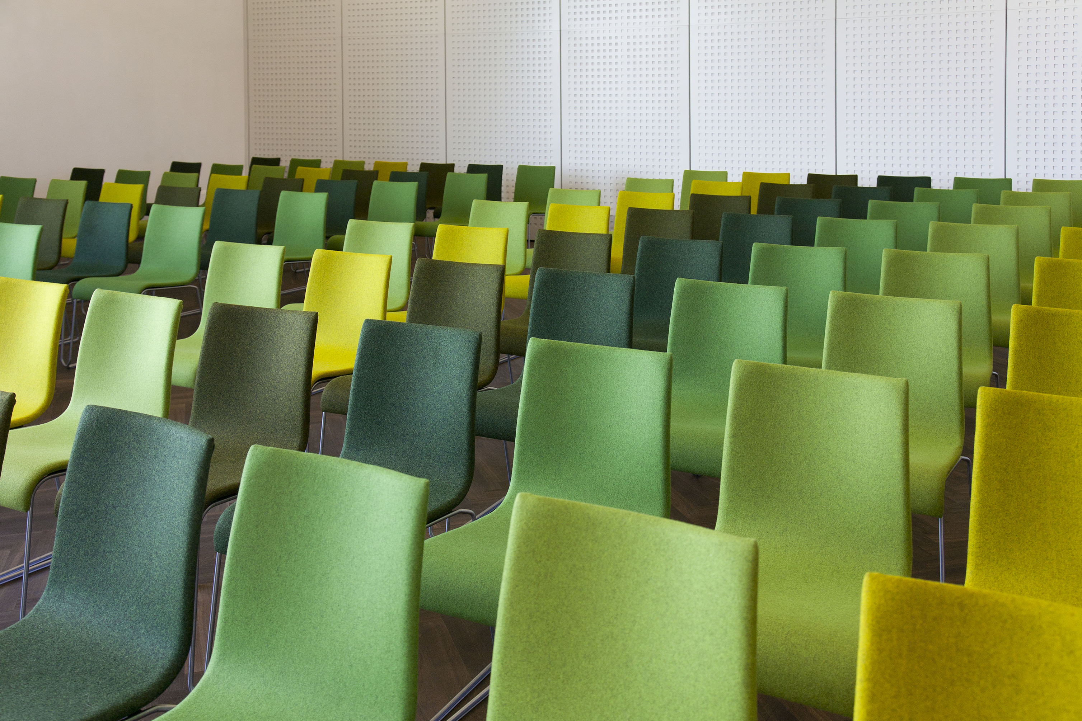
Private Development 101
The Process – How can the public get involved?
Neighborhood Meeting / Land Use Application
Written Public Comment / Land Use Application
Written Appeal / Land Use Decision
Planning Commission / City Commission / Land Use Process
Pre-Construction Meeting Attendance / Construction
Phone / Email / In-person comments / Construction
Type II
Type III / IV

Slide 10

Private Development 101
The Standards
Planning
  State Land Use Laws
  City Code
Engineering
  City Code
  Engineering Design Standards
Building
  State Building Codes
Notes:
Planning : Land Use Laws (19 Statewide Land Use Planning Goals) administered by DLCD
Planning : City Code chapter 12,16,17 plus various concept plans
Engineering : City Code chapter 12,13,15,16,17
Engineering : Water, Sanitary Sewer, Stormwater, Street Design Standards plus various corridor plans
Building : Oregon Structural Specialty Code and other related Oregon Specialty Codes

Slide 11
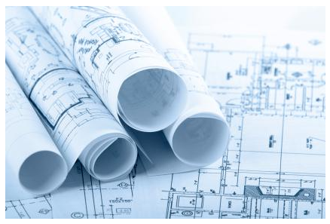
Private Development 101
City Public Works References
https://www.orcity.org/publicworks/engineering-development-services
ocpublicworks@orcity.org
971-204-4601
Notes:
The development services page has links to the land use process, code, permit forms and documents, design standards, and more
Review Planning and Building pages on the City website.
We also have recorded educational presentations in the past few years on Geologic Hazards and Traffic Engineering available for view on the development services webpages.

Slide 12

Private Development 101
More Information
Construction Projects Map
https://www.orcity.org/maps/construction-projects
Project Websites
https://www.orcity.org/projects
Public Meetings
https://www.orcity.org/meetings
Notes:
The project maps shows all development generally under construction including road and utility projects as well as private development – this map is updated annually.
Project websites are for any private development which is going through a land use process as well as capital improvement projects such as parks, roads, utilities.
Public meeting information is listed here and videos can be found here and on youtube.

Slide 13
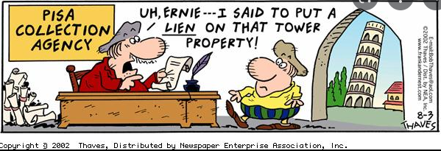
Private Development 101
Conclusion
Notes:
So often we speak different languages as shown in this comic strip. Our hope is that this presentation will help us to speak the same language and assist with how we can work together.
City staff cannot complete work contrary to codes and standards, but sometimes interpretations are needed as clearly was needed in this comic strip here.
We encourage your questions throughout the development process!

Slide 14

Private Development 101
Let’s hear from you!
What can we do differently?
What forms of engagement can we add or change besides:
  Project Websites, Webpages, and Maps
  Required neighborhood meeting
  Mailings of properties within 300 feet
  E-mail, Phone, and in-person availability
Notes:
While there are opportunities to make public comment such as … (list bullet points)
Are there things we can do differently? Are there ideas for communication that would enhance the ability for the public to engage and feel like they are heard?
Being heard does not necessarily mean that a project cannot go forward or should not be built, but in some cases it may! If a project does not meet the standards as interpreted by you using the code and standards, we need to hear that.
If a project can make a change to meet your needs to reduce impacts to you, please make those comments – in many cases developers are willing to make those adjustments and in many cases, staff can require these items.
Any comments? Questions?

