Slide 1
Oregon City Loop Trail Connections Stakeholder Workshop
October 10, 2022

Slide 2
Agenda
5 minutes | Meeting Welcome & Overview
15 minutes | Overview Presentation & Questions
30 minutes | Walking Audit
10 minutes | Wrap-Up

Slide 3
Meeting Purpose & Objectives
Provide an overview of the Oregon City Loop Trail Plan Study
Gather feedback on the proposed Meyers-Beavercreek segment
Share opportunities and constraints for the Meyers-Beavercreek segment
Provide an opportunity for stakeholders to ask questions

Slide 4
Project Overview
In 2004, the Oregon City Trails Master Plan was completed
Sets the vision for the City’s trail system
Identified the Oregon City Loop Trail as a regional trail
Provides guidance for how trails should be constructed
Insert map of entire Loop Trail

Slide 5
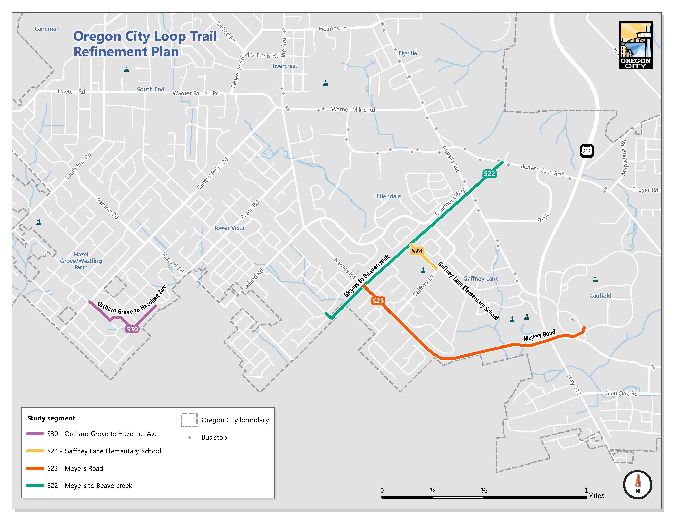
Project Overview
In 2013, the Oregon City Transportation System Plan (TSP) was completed
Provides a long-term guide for City transportation investments
Includes projects that would build segments of the Loop Trail and connections to the Loop Trail
This study is focusing on four segments identified in the TSP

Slide 6
Project Goals
Refine proposed design for the four segments
Identify where to build the trail
Determine how wide the trail should be and what type of trail should be built
Position the City to secure funding to construct trails or require development to construct them

Slide 7
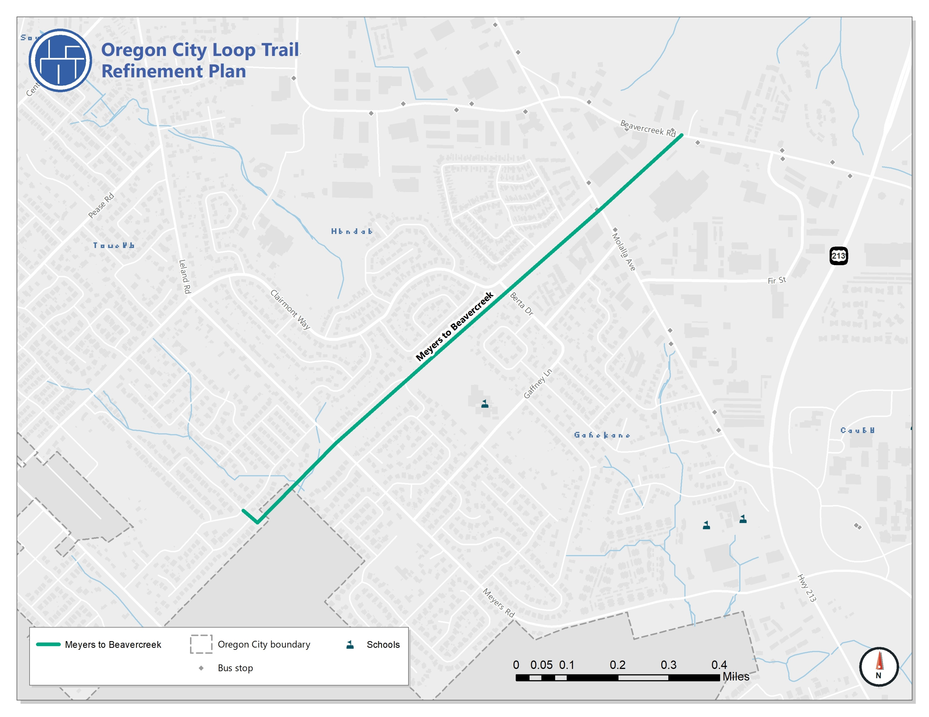
Meyers-Beavercreek (Power Lines Trail)
Intended to provide an off-street connection to the Loop Trail for people walking and biking
Proposed to follow the power lines
As a local trail, it should provide access for all users

Slide 8
Meyers-Beavercreek (Power Lines Trail)
Intended to provide an off-street connection to the Loop Trail for people walking and biking
Proposed to follow the power lines
As a local trail, it should provide access for all users

Slide 9
Opportunities
Provide an off-street connection for walking and biking to Gaffney Lane Elementary School
Existing easement for power lines from Beavercreek Road to Frontier Parkway
Large portions of the proposed trail are owned by the City
School district is supportive
Insert simplified Land Use Map highlighting opportunities

Slide 10
Constraints
Navigating retail center between Beavercreek Road and Molalla Avenue
Access between Berta Drive and elementary school
Meyers Road to Frontier Parkway connection
Maintaining adequate distance from power lines
Insert simplified Land Use Map highlighting constraints

Slide 11

Share your thoughts!
Questions about the study
Concerns about the trail and proposed alignment
Would you use the trail?
Where would you use the trail to go?

Slide 12
Next Steps
Project team will be developing alternatives for alignments
Once alignment is identified the appropriate trail width and surface will be identified
Share updates and opportunities for input throughout the study

