Slide 1
Oregon City Loop Trail: Project Update
June 13, 2023

Slide 2
Agenda
Project Background & Purpose
Meyers to Beavercreek (S22): Opportunities & Constraints and Outcomes
Gaffney Lane Elementary (S24): Opportunities & Constraints and Outcomes
Meyers Road (S23): Opportunities & Constraints and Outcomes
Orchard Road (S30): Opportunities & Constraints and Outcomes
Next Steps

Slide 3
Project Update
Provide an overview of the project background and purpose
Present the proposed alignments and cross-sections for each trail
Share next steps and answer questions

Slide 4
Project Background & Purpose
Oregon City Loop Trail is identified in the City’s Trails Master Plan
The Transportation System Plan (TSP) includes projects to complete segments of trail and ancillary paths
This project begins the project refinement process
Positions the City to add projects to the CIP, apply for grant funding, and condition development to design/construct portions of the trail

Slide 5
Project Outcomes
Determine the appropriate alignment for the trail segments
Develop cross-sections for the segments based on available Right-of-Way (ROW)
Prepare cost-estimates based on alignment and cross-sections.
Identify grants that the City could apply for to fund design/construction of trails

Slide 6
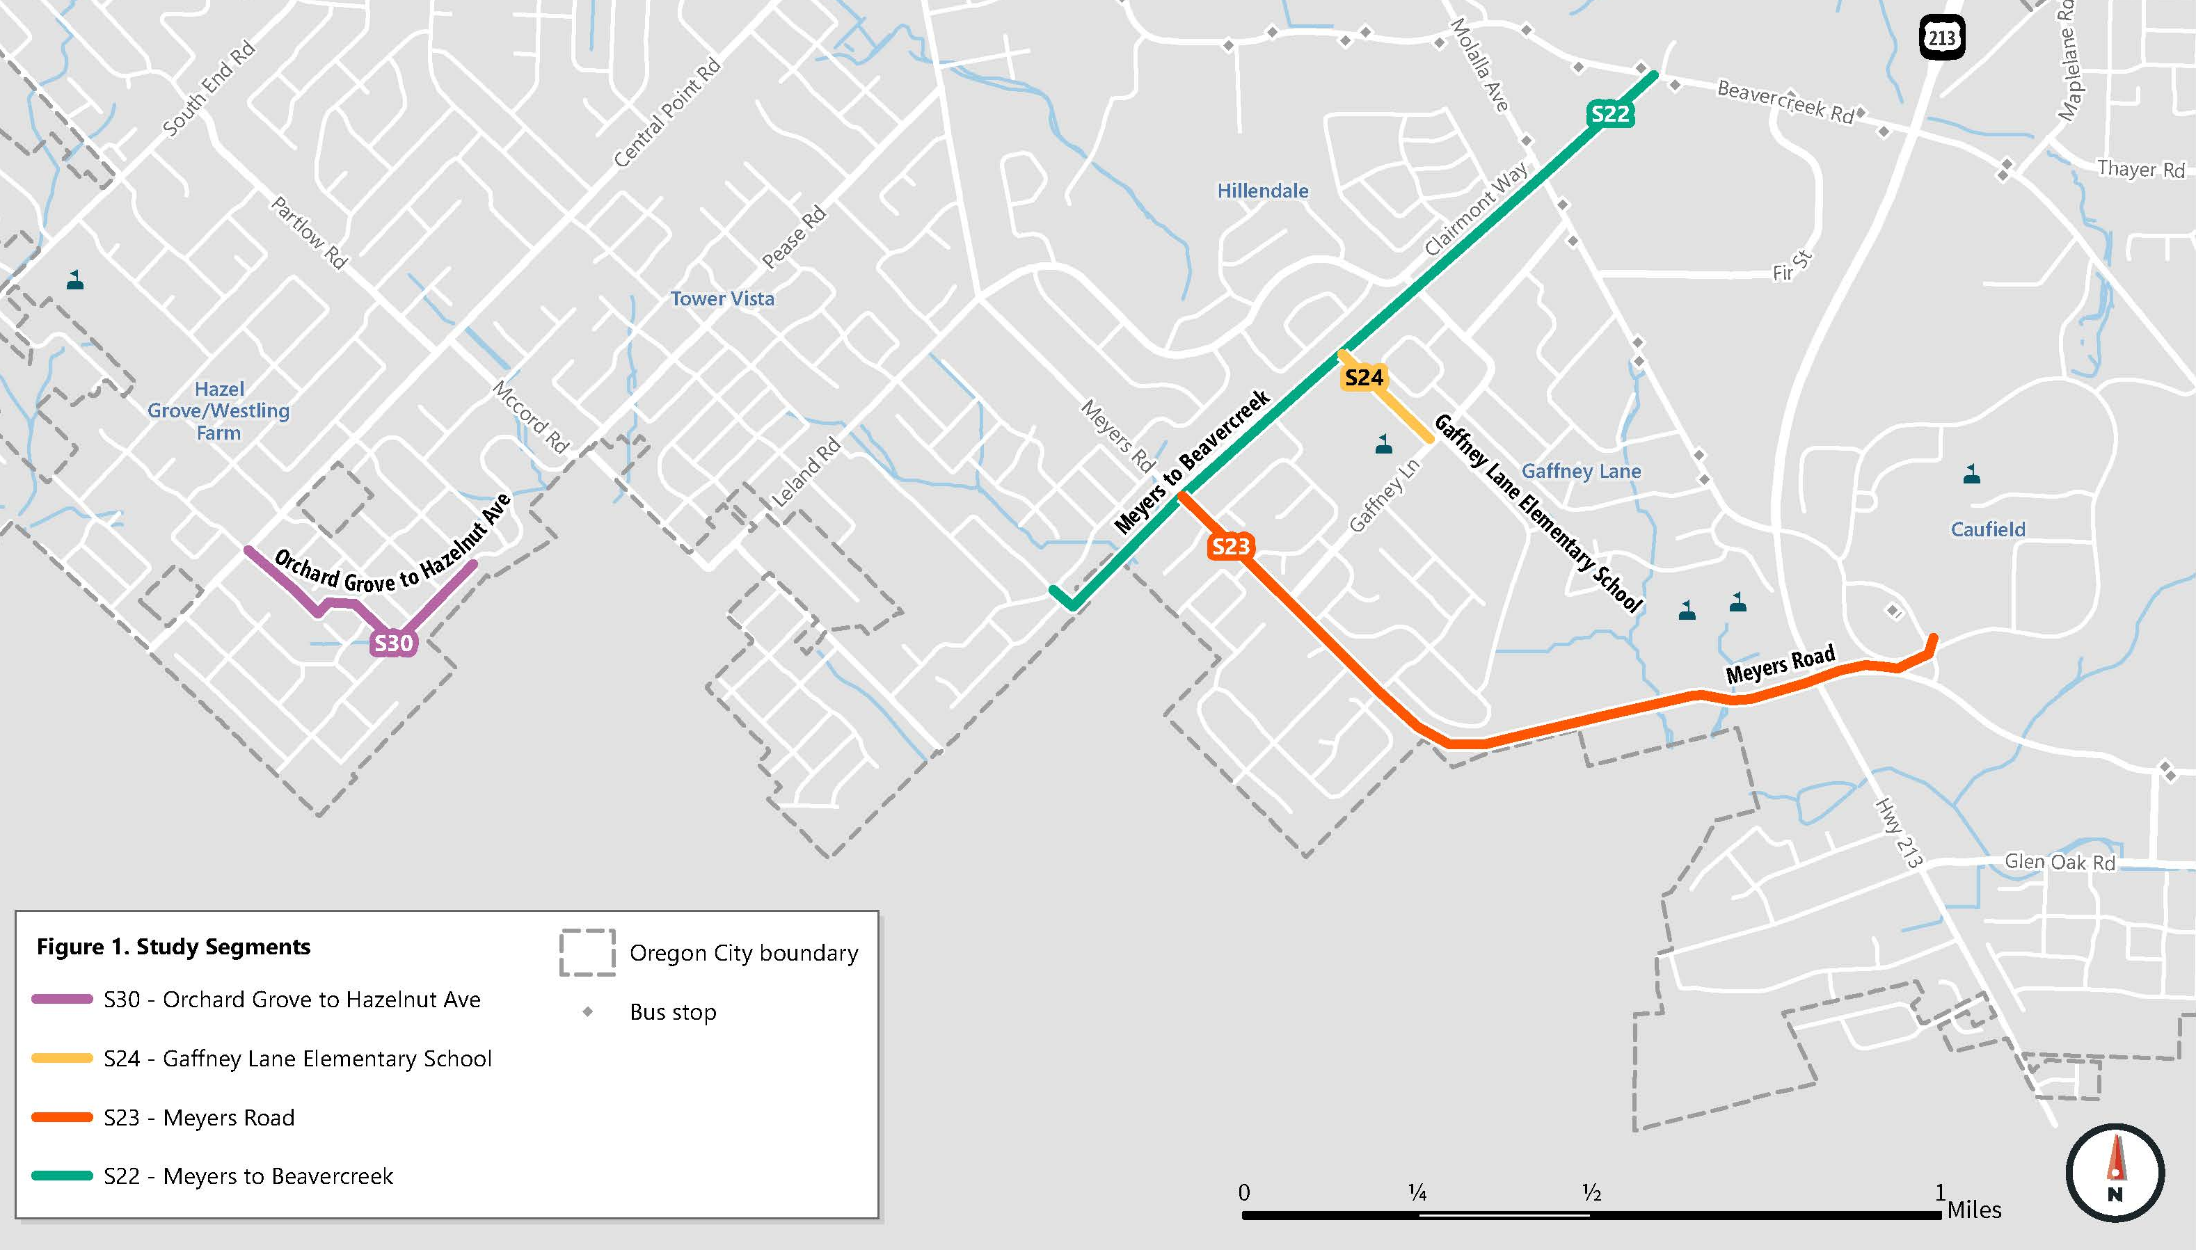
Project Overview: Trail Segments

Slide 7






Opportunities & Constraints
Identifying opportunities & constraints focused on:
Previous Planning Efforts | Surrounding Land Use & Context | Land Ownership & Right-of-Way (ROW) | Existing Infrastructure | Utilities | Environmental Constraints

Slide 8
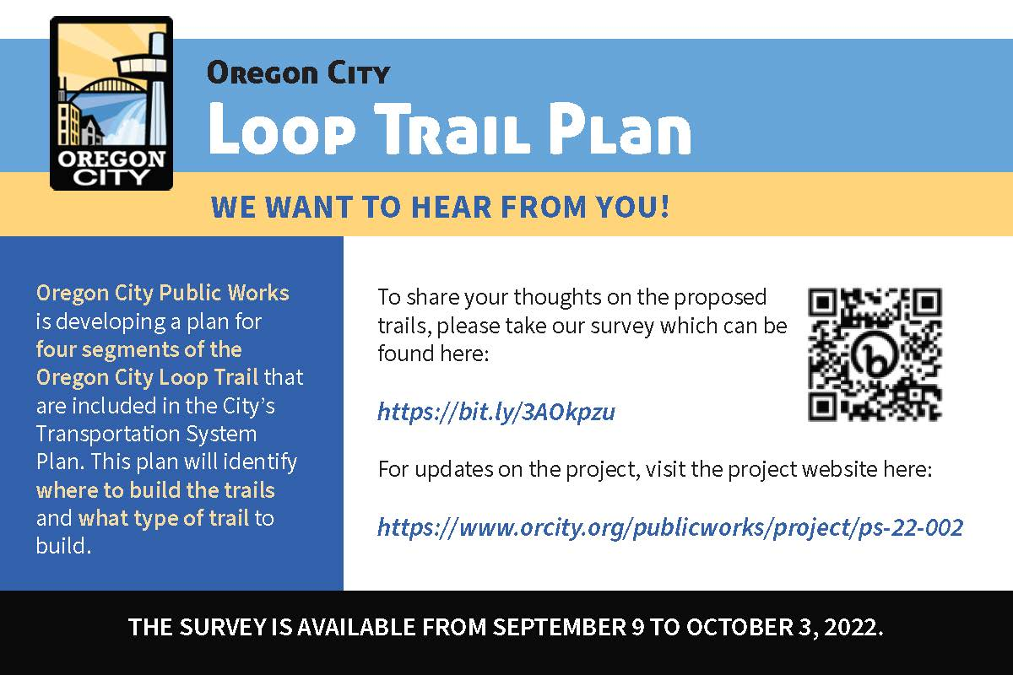
Community Outreach
Opportunities for community members to participate included:
Online survey – live from September 9th to October 3rd , 2022.
Promoted with a postcard and on City’s social media
In-Person Workshop – October 10th, 2o22.
Held at Gaffney Lane Elementary
24 Attendees
Shared opportunities and constraints for Meyers-Beavercreek and included walking audit

Slide 9
Development of Trail Alignment
Developed evaluation framework to evaluate potential alignment options
Key evaluation criteria included:
Does the proposed alignment minimize impact to privately owned properties?
Does the proposed alignment minimize impacts to natural resource areas?
Does the proposed alignment utilize areas where there is an existing easement or city owned land?
Does the proposed alignment align with regional priorities for trails funding?

Slide 10
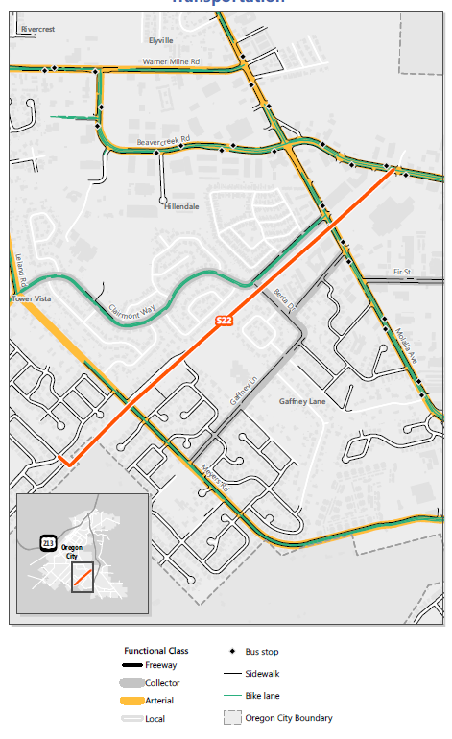
S22 – Meyers Road to Beavercreek Road
Segment would create a connection from planned regional trails to Wesley Lynn Park
Opportunities:
Land along proposed alignment owned by the City & School District
Connection to Gaffney Lane Elementary
Constraints:
Stormwater detention basin and wetland areas near Meyers Road
Proximity to homes between Berta Drive and Meyers Road

Slide 11
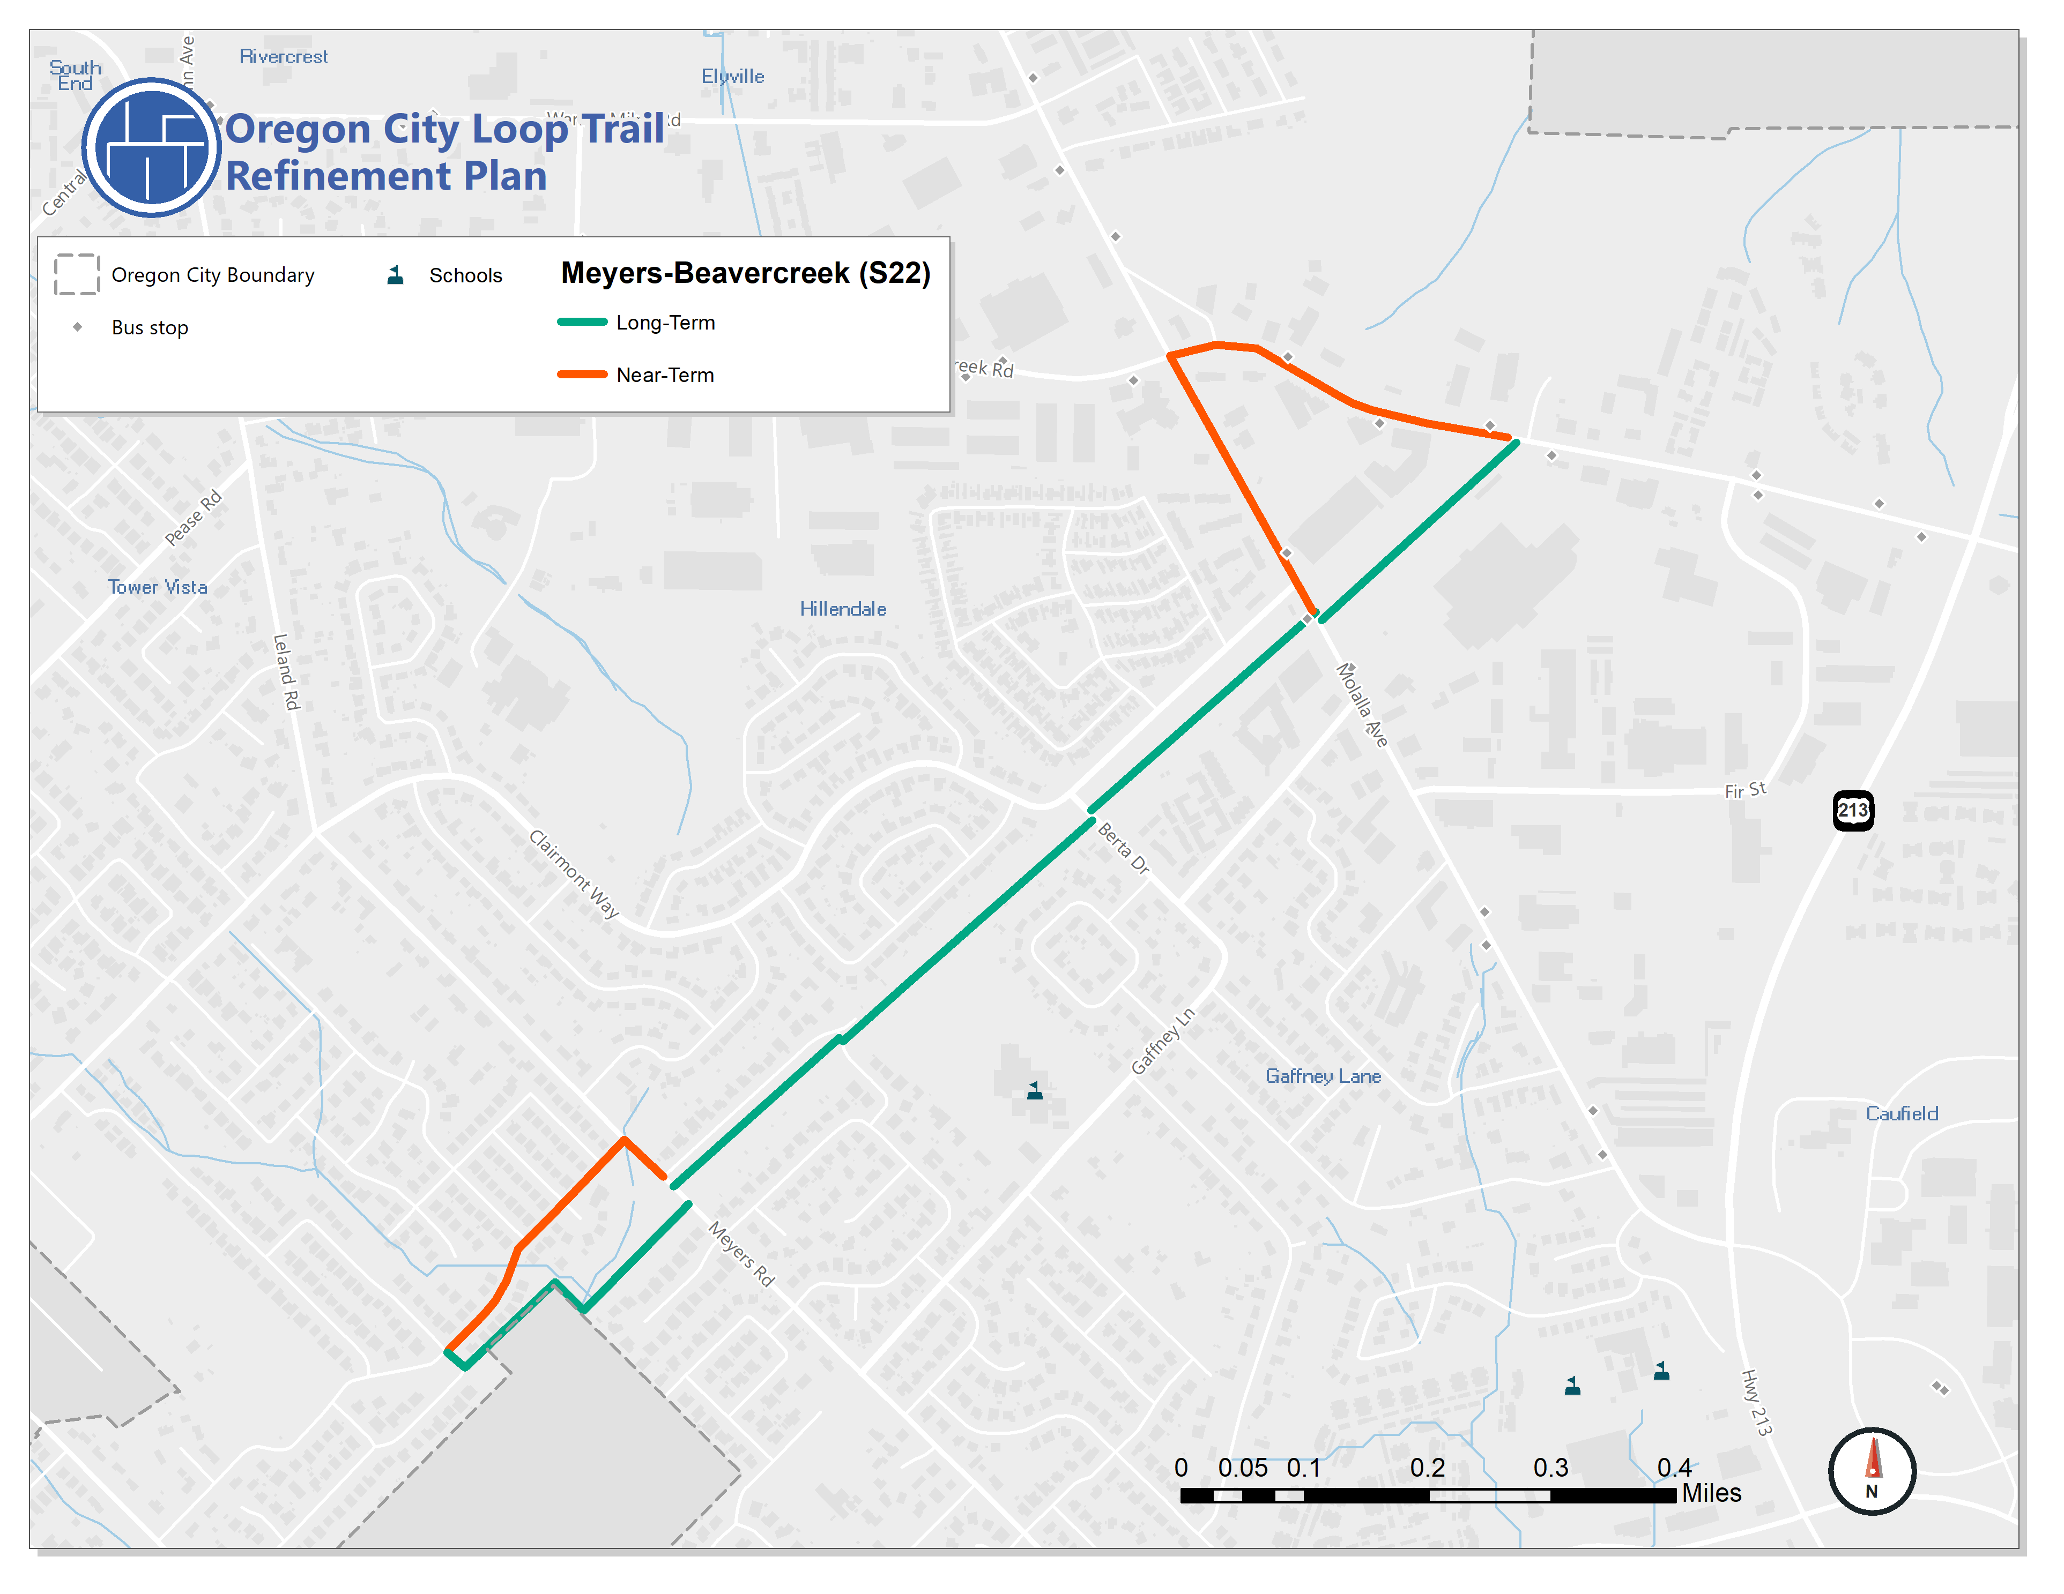
S22 – Meyers Road to Beavercreek Road
Alignment includes two portions with near-term options
Near-term options utilize existing roadways to create connections where long-term alignment will be more challenging to construct

Slide 12
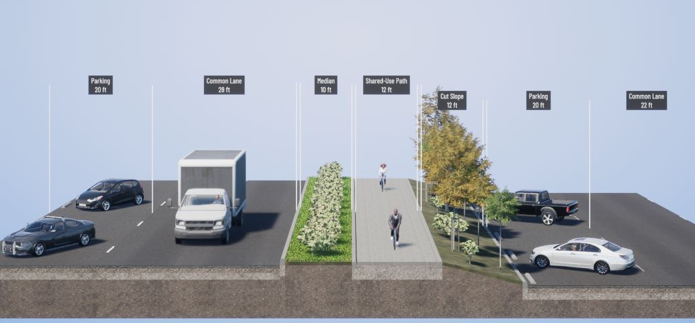
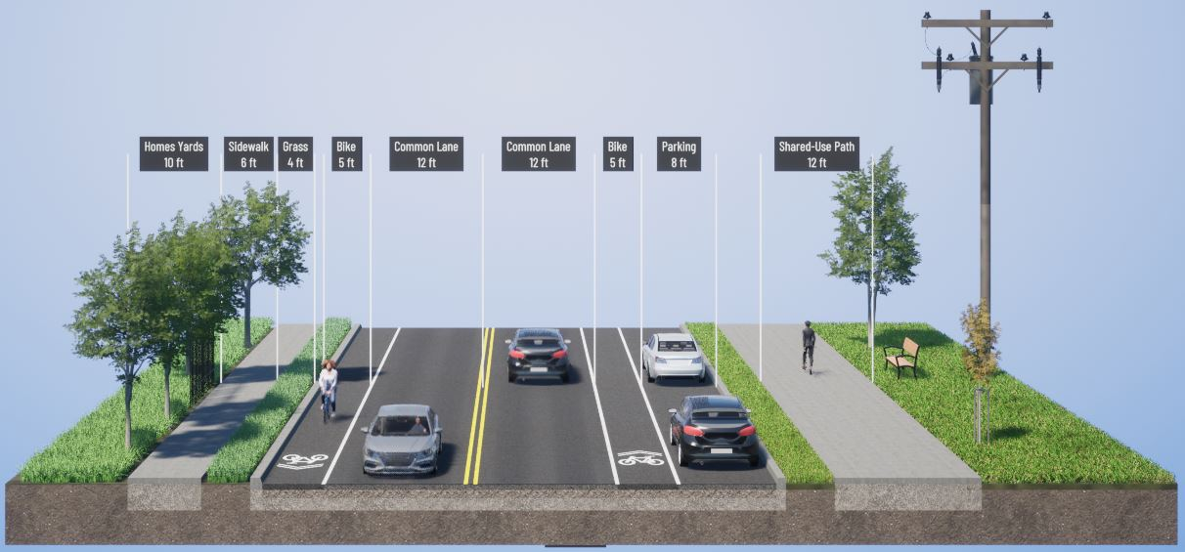
S22 – Meyers Road to Beavercreek Road
Near-term options use existing sidewalks and bicycle lanes on Beavercreek and Molalla to make connections in the near-term
Long-term vision would create a path outside the existing roadway between Beavercreek & Frontier Parkway
Proposed cross-section provides a 12’ shared-use path
Connection through Retail Parking Lot
Shared-Use Path on Clairmont Way

Slide 13
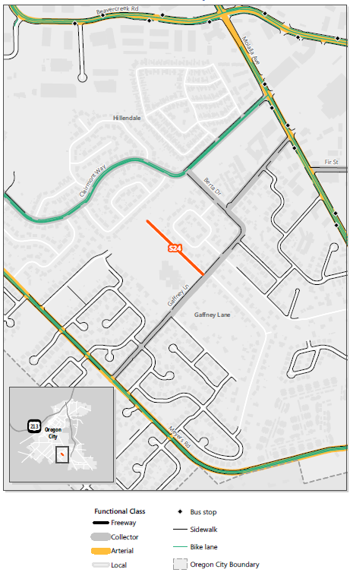
S24 – Gaffney Lane
Provide a connection for elementary students to off-street connections and residential areas
Opportunities
Rudimentary path already exists and is well utilized
School district is supportive of improving connection
Constraints
Existing sidewalks gaps on Gaffney Lane will need to be addressed to improve future connections

Slide 14
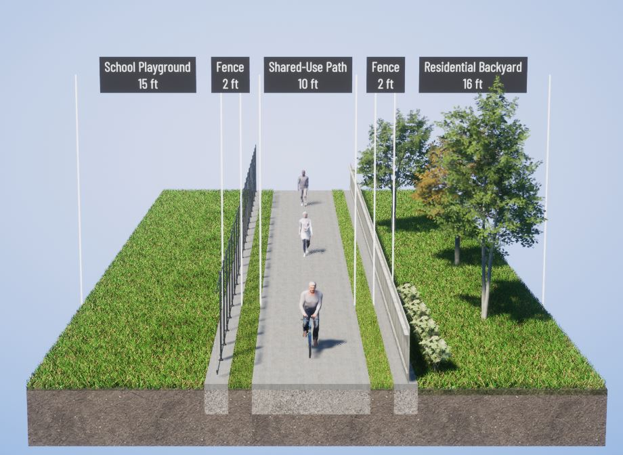
S24 – Gaffney Lane
Proposed cross-section provides a 10’ shared-use path
Will widen and pave existing path
Uses space between the school playground and residential homes
Enhances connection to planned Meyers-Beavercreek Trail

Slide 15
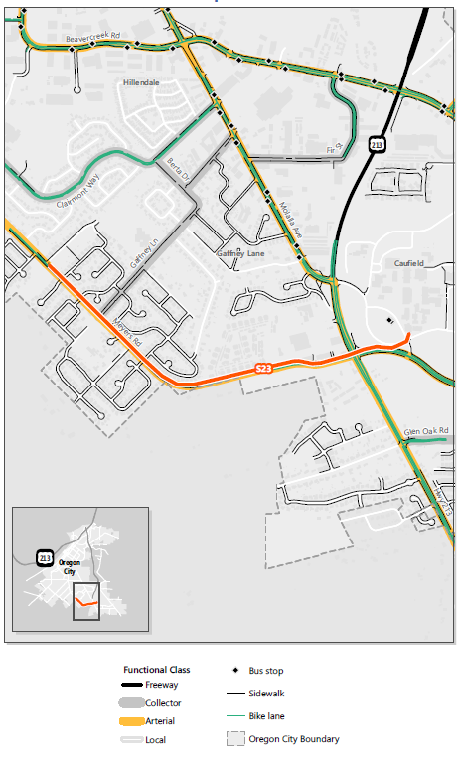
S23 – Meyers Road
Portion of Oregon City Loop Trail that will connect from Clackamas County Community College to Frontier Parkway
Opportunities
Many CCC students live in apartments on Meyers Road
People currently travel to CCC for recreational walking/biking
Constraints
Land use along Meyers Road is built out
No space to improve existing facilities within the current cross-section

Slide 16
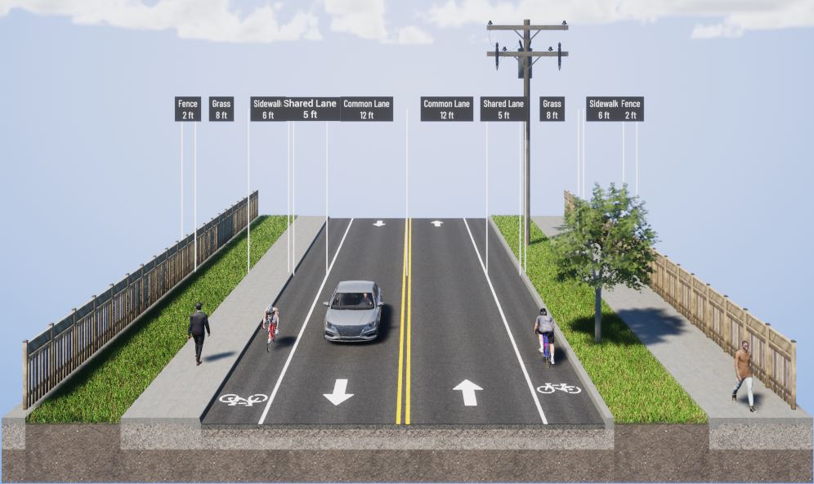
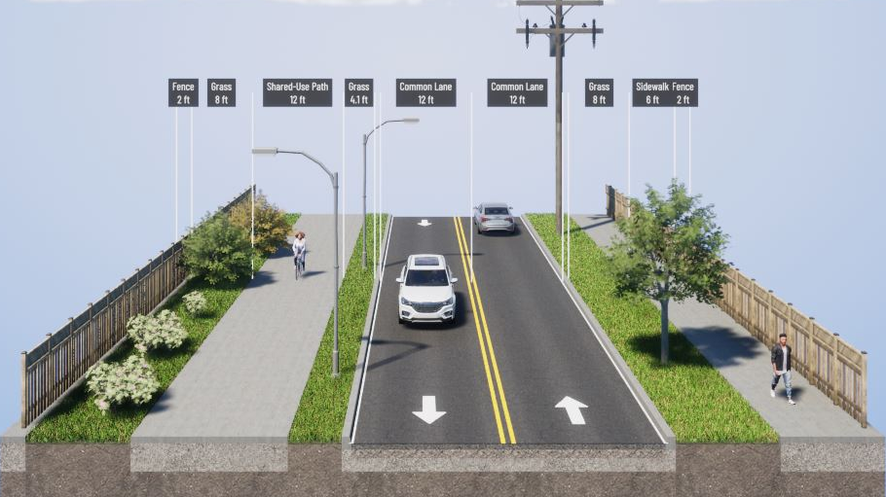
S23 – Meyers Road
Proposing to move the existing curb and remove existing on-street bicycle lanes
Create a 12’ shared-use path on the north side
Maintain existing sidewalks on the south side
Off-street connection would qualify for trails funding
Existing
Proposed

Slide 17
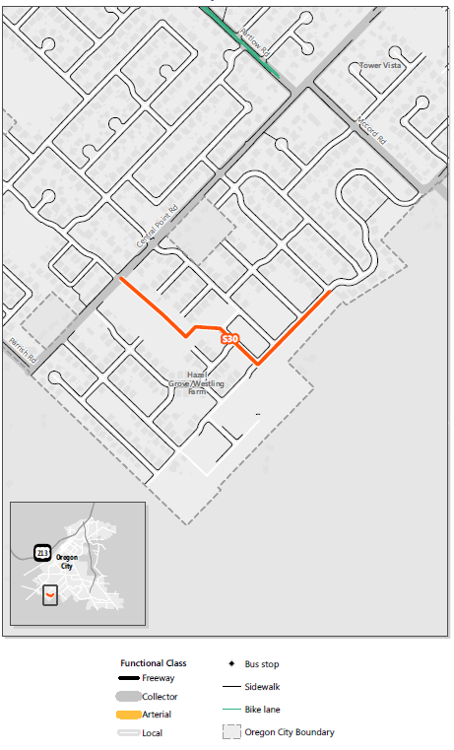
S30 – Orchard Grove Dr / Hazelnut Avenue
Portion of the Loop Trail that will connect to Hazelwood Park and John McLoughlin Elementary School
Opportunities:
Portions of the roadway network have not been built yet
Most existing roadways have sidewalks and bike lanes
Constraints:
Connection through undeveloped property will be reliant on development

Slide 18
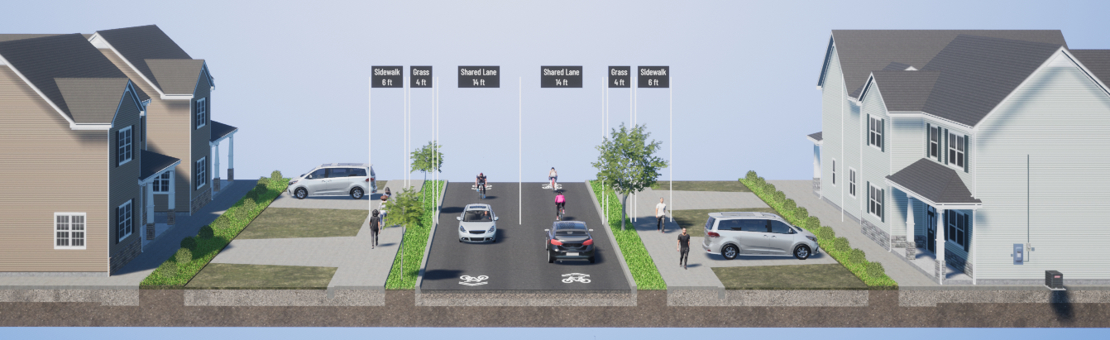
S30 – Orchard Grove Dr / Hazelnut Avenue
Proposed concept maintains the existing roadway cross-section
People walking will use existing sidewalks
Vehicle travel lane will be shared with people riding bicycles
New roadway connections should be built with the same cross-section

Slide 19
Next Steps
Finalize cost-estimates
Share outcomes with residential areas surrounding Meyers Road
Finalize report documenting outcomes

